Slide 1
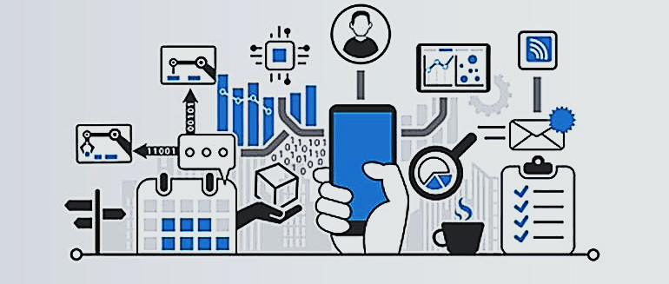

WYTEDGE

Slide 2
Agenda
WYTEdge
Introduction
1
Project
Overview
2
Project
Objectives
3
Project
Walkthrough
4
Project
Demo
5
Audience
Talk
6

Slide 3
Introduction
Multi-Form Technology
Aim
Robotic automation, Online System
To improve the energy monitoring process
Interactive Analytical Display
Modern
It is a digital solution
Industry 4.0
Analyzing results is easier
Notes:
Technology is not limited to what think like computers, laptops, smartphones, ipods, ipads and all.
We are aware that IOT(that is robotics) have already made their entry in the digital era we are living.
By multi-form, I mean:
Wytedge can be a fully robotic automatic system
Or an Android App which is a semi automatic system
Or a Web application
Or even a desktop application

Slide 4
Introduction
Multi-Form Technology
Aim
Robotic automation, Online System
To improve the energy monitoring process
Interactive Analytical Display
Modern
It is a digital solution
Industry 4.0
Analyzing results is easier
Notes:
Wytedge follows the modern technological trend, evolving alongside with industry 4.0 which focuses on smart manufacturing technologies.
Nevertheless, the manufacturing industry is one of the hardest sectors to merge with the digital era, because it involves much more machinery, paperwork as well as resources.

Slide 5
Introduction
Multi-Form Technology
Aim
Robotic automation, Online System
To improve the energy monitoring process
Interactive Analytical Display
Modern
It is a digital solution
Industry 4.0
Analyzing results is easier
Notes:
The aim here is basically Effective Energy Monitoring.
Automating time-consuming tasks.
Accurate analysis of energy being consumed

Slide 6
Introduction
Multi-Form Technology
Aim
Robotic automation, Online System
To improve the energy monitoring process
Interactive Analytical Display
Modern
It is a digital solution
Industry 4.0
Analyzing results is easier
Notes:
Well, analytics is a very important aspect of monitoring which will determine the next step in maintenance.

Slide 7

Overview
1
2
3
Fully Automatic IOT Based System
Android Semi-Automatic System
Online Web Interface

Slide 8
Overview
1
2
3
Fully Automatic IOT Based System
Android Semi-Automatic System
Online Web Interface

Slide 9

Overview
1
2
3
Fully Automatic IOT Based System
Android Semi-Automatic System
Online Web Interface

Slide 10
Overview
1
2
3
Fully Automatic IOT Based System
Android Semi-Automatic System
Online Web Interface

Slide 11
Objectives
Effective Energy Monitoring
Evolve Towards Industry 4.0
Improve Time Effectiveness and Increase Productivity
Accurate and Flawless
Notes:
Industry 4.0 is the trend towards automation and data exchange in manufacturing technologies and processes which include IOT, IIOT, Cloud Computing, Artificial Intelligence.

Slide 12


IOT System
SENDER
RECEIVER
Sensor
GSM Module
Microcontroller
SMS Message
Microcontroller
Screen
Screen
Ethernet Shield
GSM Module
Database Server

Slide 13
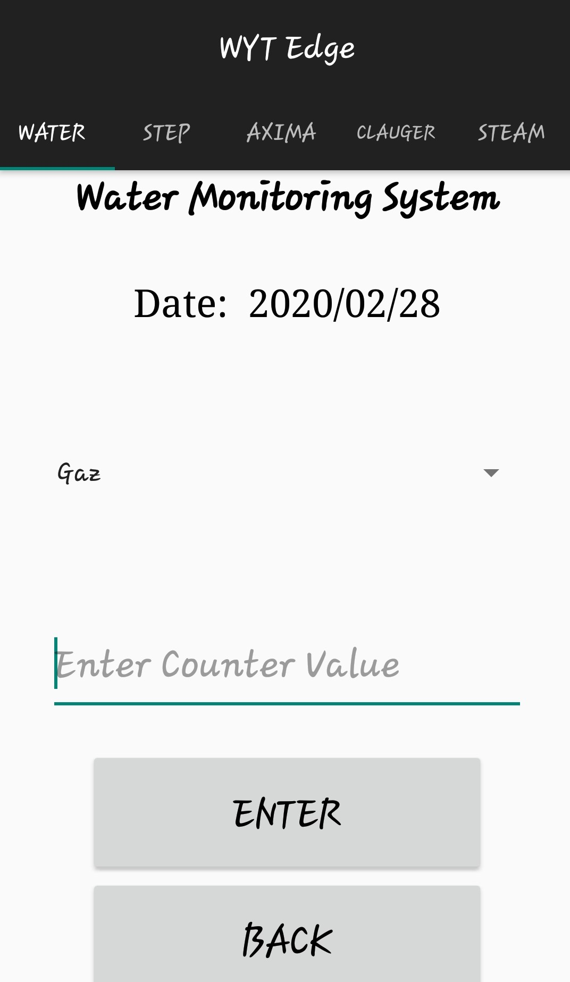
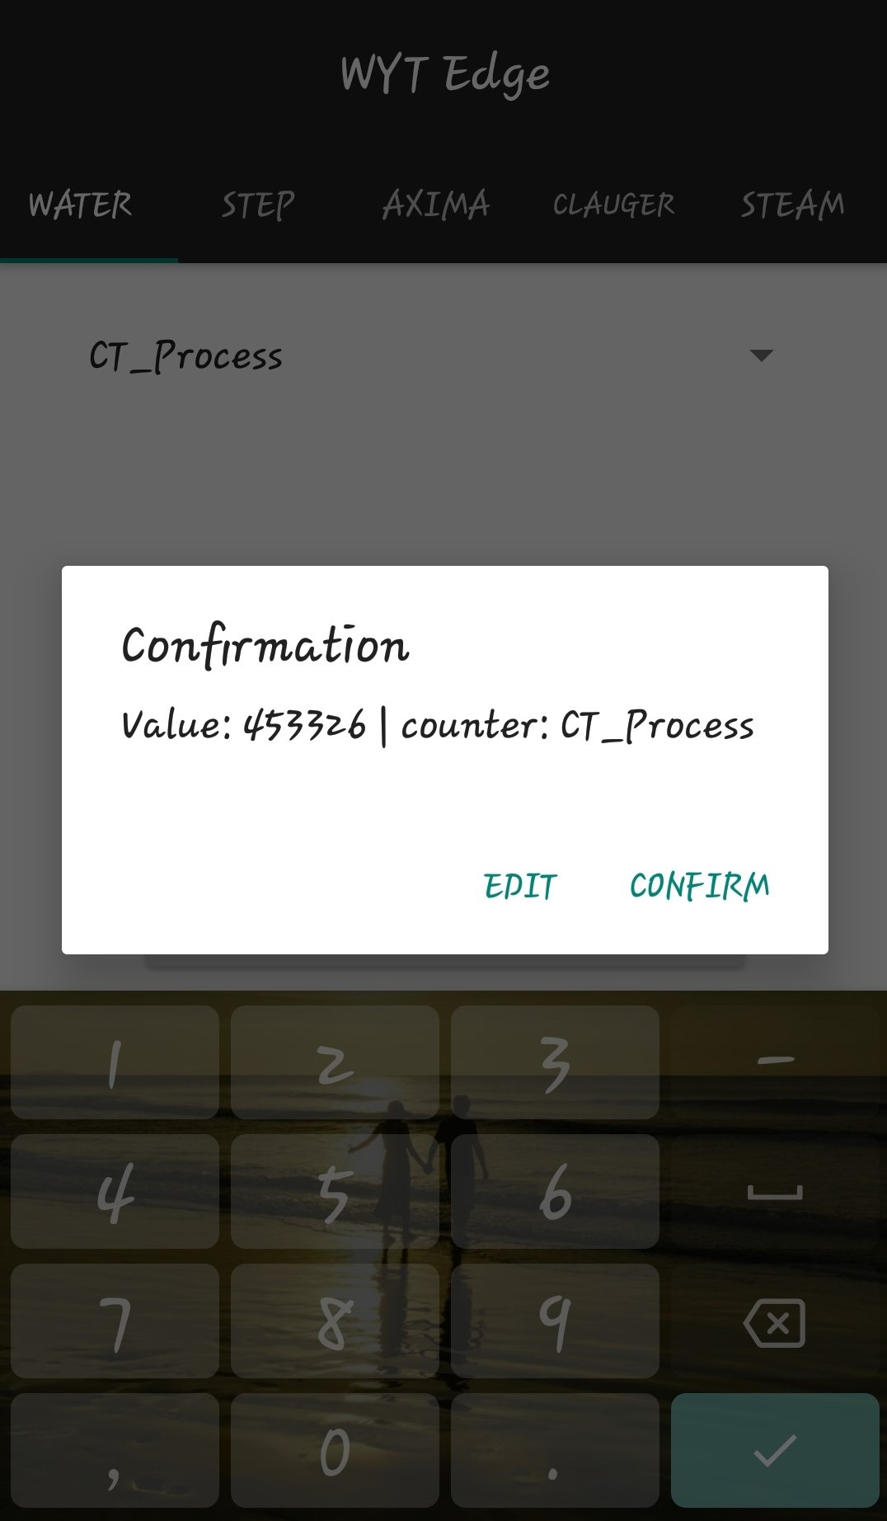
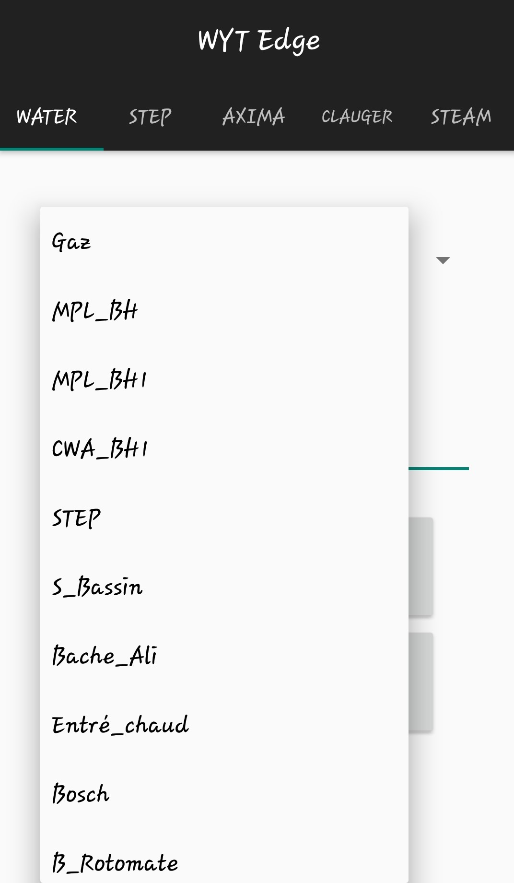
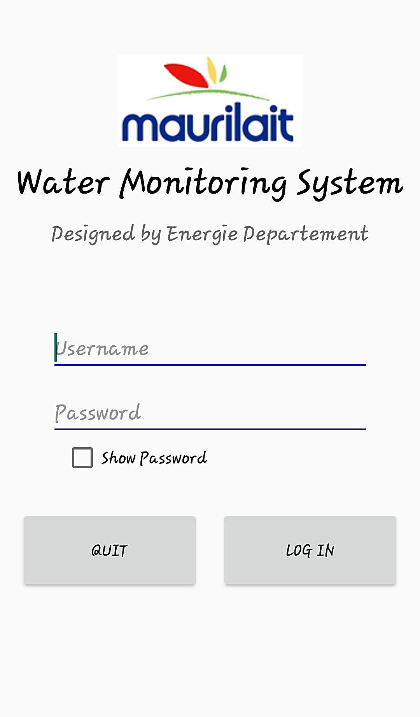
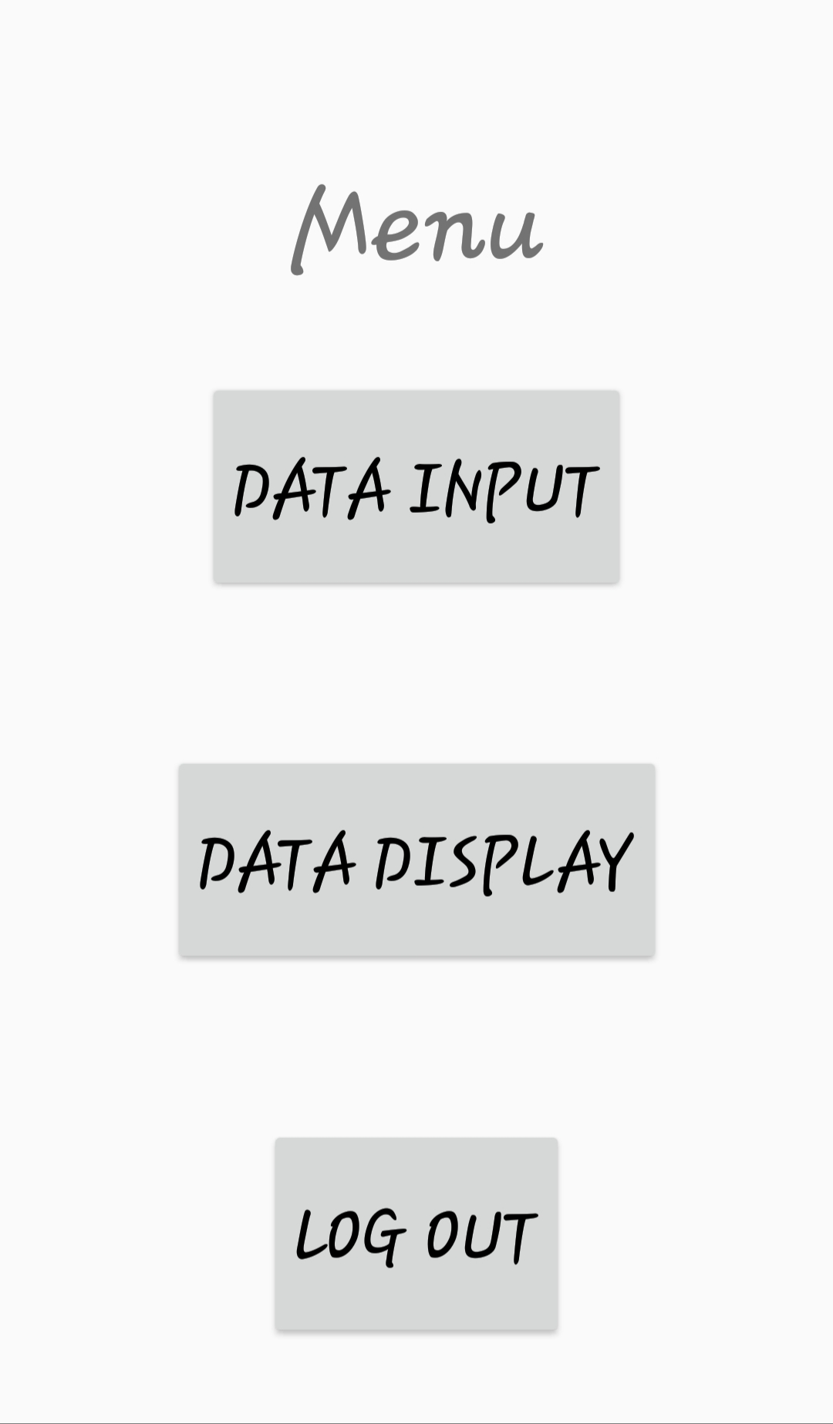

Android Monitoring System
1
Username and Password required to login
2
Quick Menu Interface to input or view data fast
3
The interface to input the values is in tabbed menu form.
4
The meters are listed in dropdown view
5
Confirmation Dialog to doublecheck
6
Automatic switch to next counter after successful insertion

Slide 14
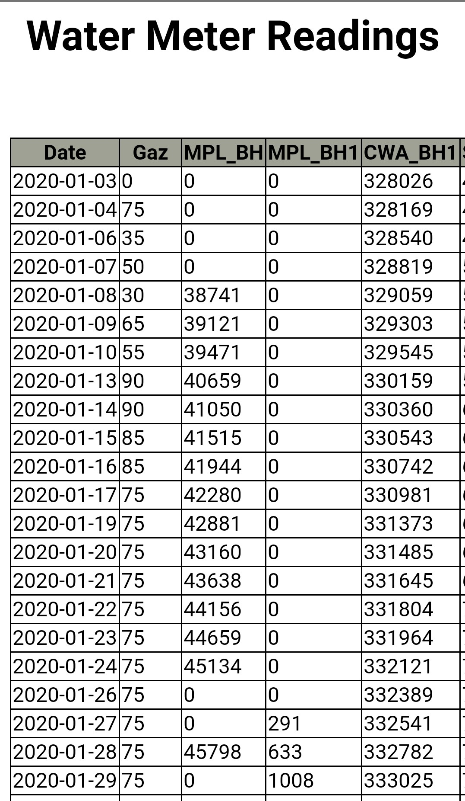
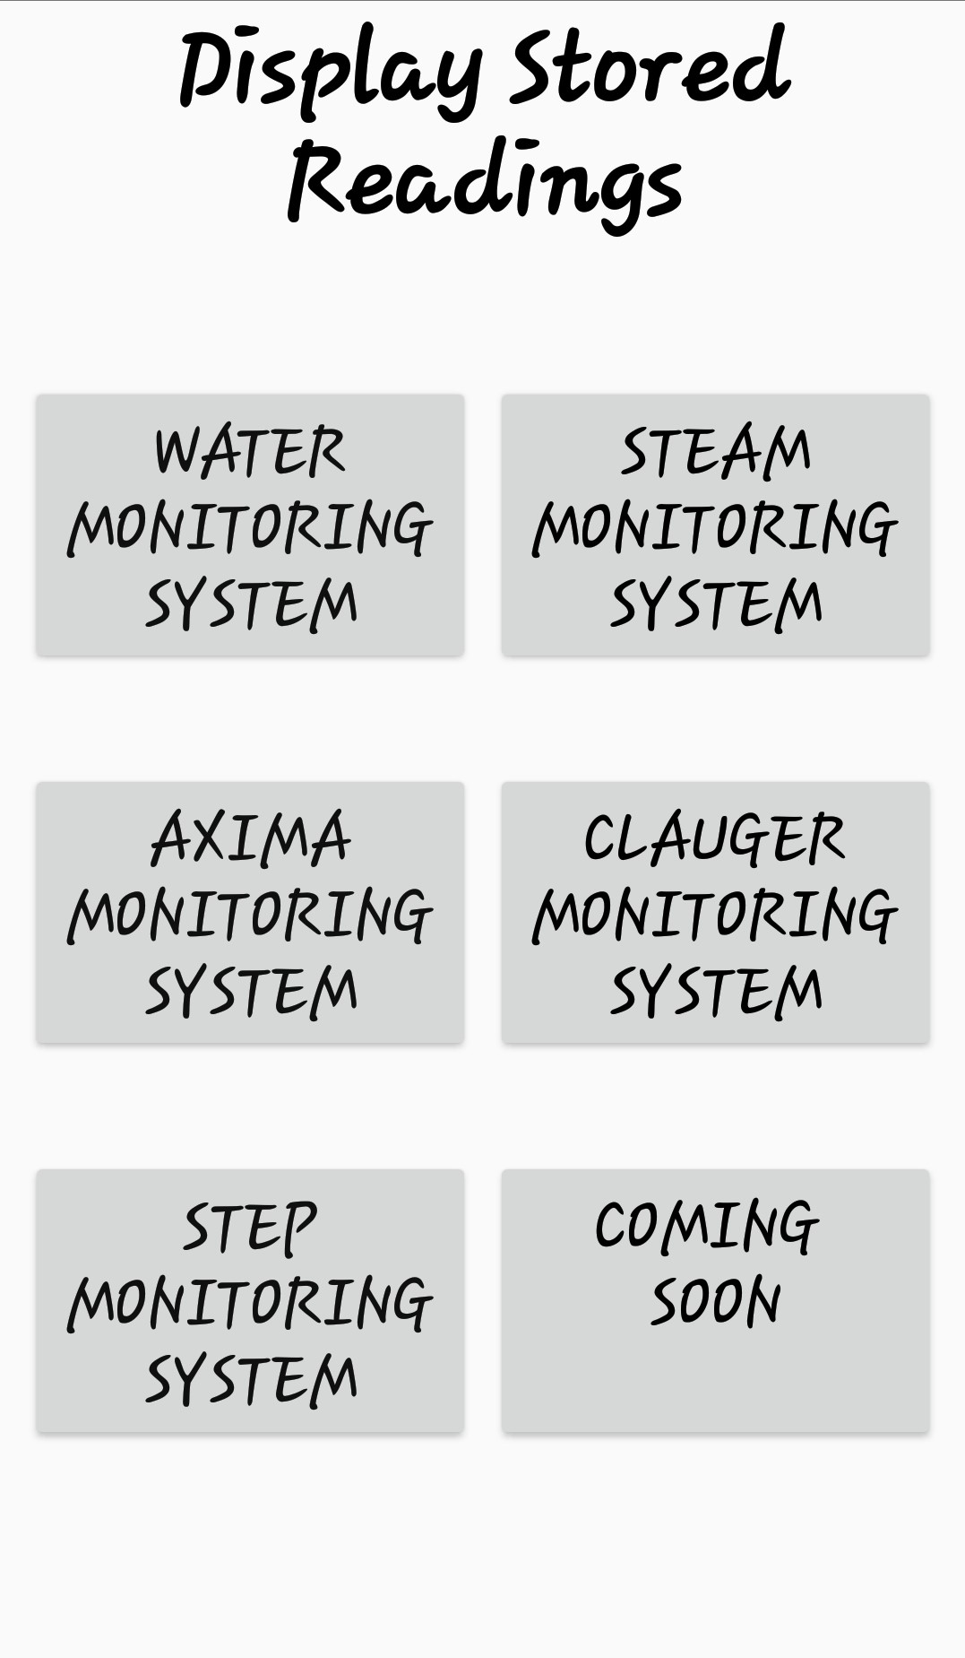
Android Monitoring System
7
Simplest Interface for quick reviews
8
Fetches the latest data from the database server

Slide 15
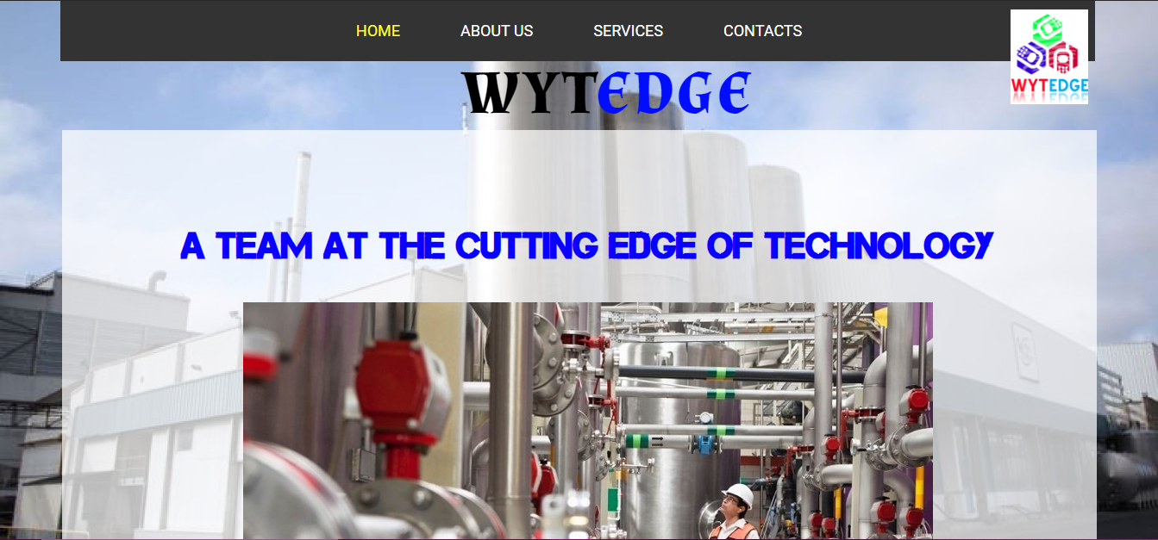
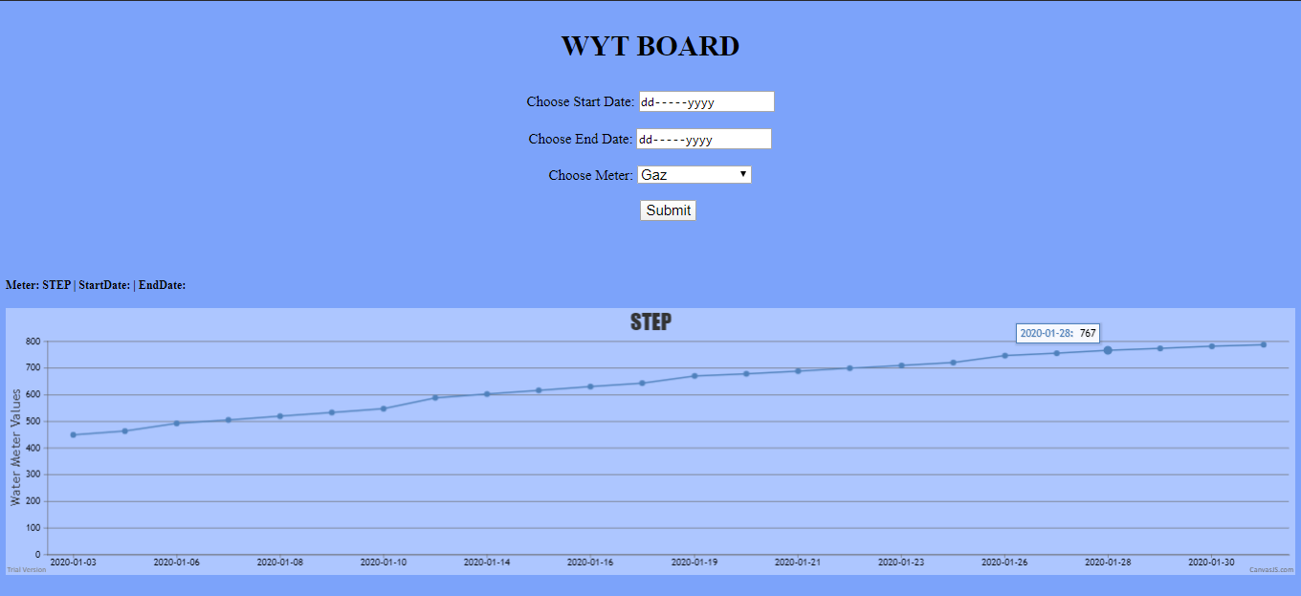
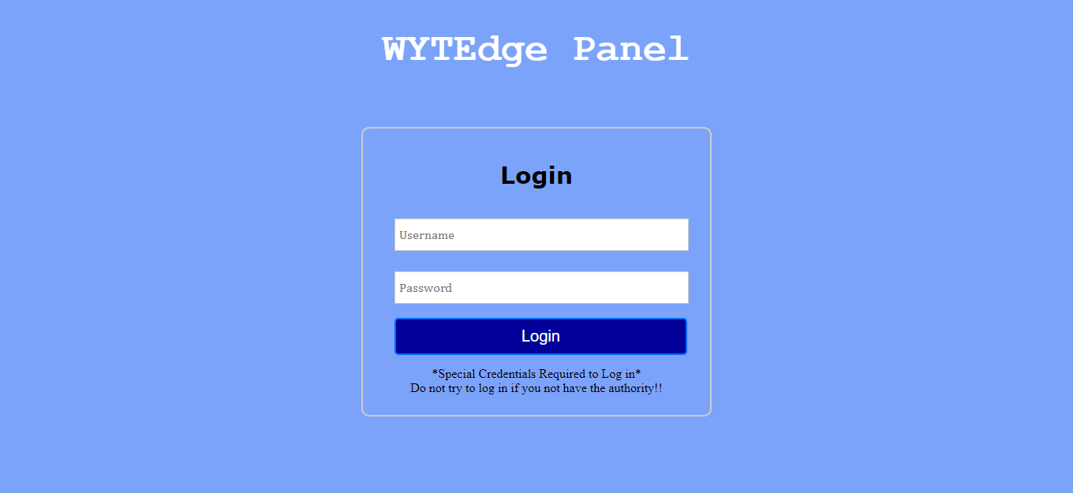
Web Interface
WYTEdge|WYTBoard
WYTEdge|Login
WYTEdge|Home
https://wytedge.tech
WYTEdge’s Website
Secure Login to Wytedge Panel
Different interfaces for technicians
Different Access Rights for different users
Table view & Graph generator for different time periods

Slide 16
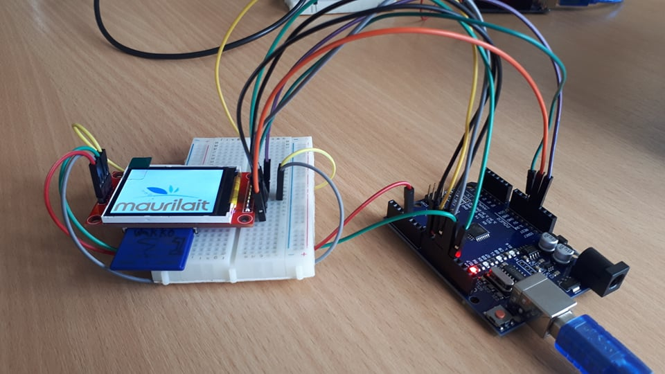
WYT Edge Demo

Slide 17
Thank You!
WYTEdge
Wafiik Aumeer
Baboolull Yougesh

